Slide 1

6th Grade Accelerated Math
Unit 6, Lesson 11 Multiplying and Dividing Integers Volume 1, pg. 283

Slide 2


Benchmark
MA.6.NSO.4.2
Apply and extend previous understandings of operations with whole numbers to multiply and divide integers with procedural fluency.
volume 1, pg. 283

Slide 3
Integrated Mathematical Thinking and Reasoning Standards
MA.K12.MTR.3.1 Complete tasks with mathematical fluency.
MA.K12.MTR.4.1 Engage in discussions that reflect on the mathematical thinking of self and others.
volume 1, pg. 283

Slide 4

Learning Target
I can multiply and divide integers with procedural fluency.
volume 1, pg. 283

Slide 5

Warm-Up
volume 1, pg. 284

Slide 6
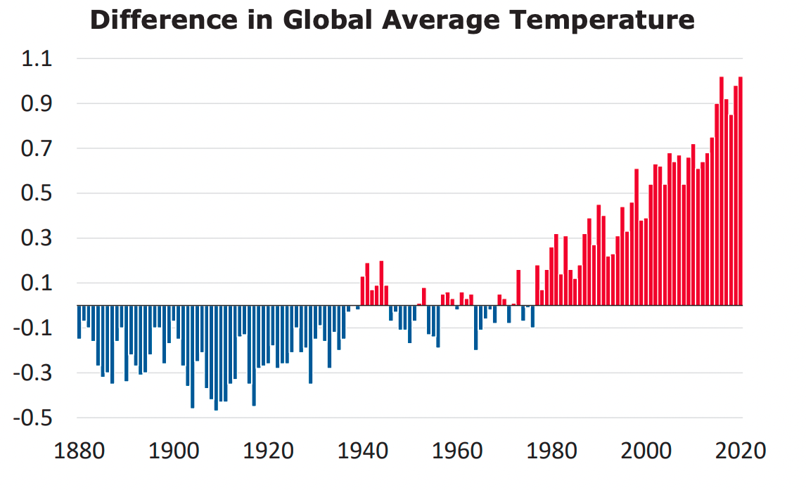
6.11.1 Warm-Up: What’s Going On in This Graph?
The graph shows the average global temperatures between 1880 and 2020 compared to the middle of the 20th century. All temperatures are in degrees Celsius (℃)
1. What are you curious about after examining the graph?
2. Imagine this graph is included in a newspaper article. Write a catchy headline that captures what’s going on in the graph.
volume 1, pg. 284

Slide 7

Refresher
volume 1, pg. 284

Slide 8

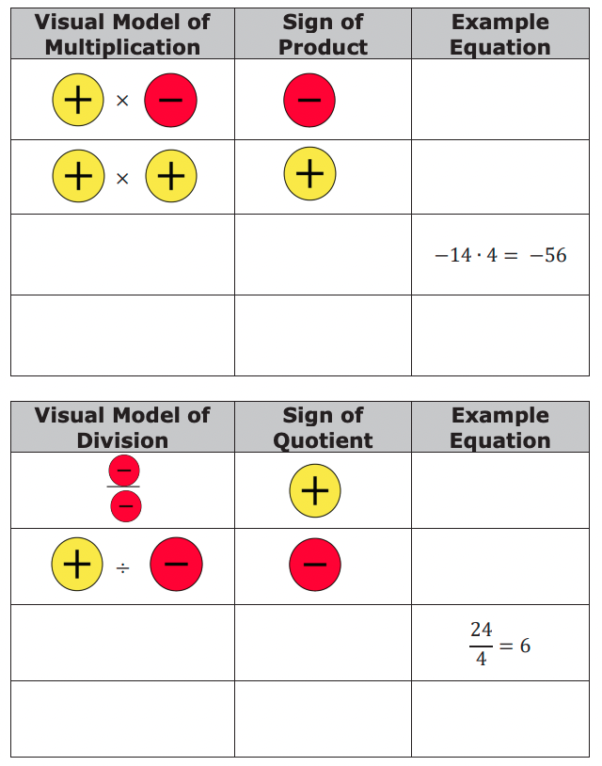
6.11.2 Refresher: Multiplying and Dividing Integers
Work with your partner to complete the tables. The last row of each table is missing both the rule and an example equation.
volume 1, pg. 284

Slide 9

Collaboration
volume 1, pg. 285

Slide 10

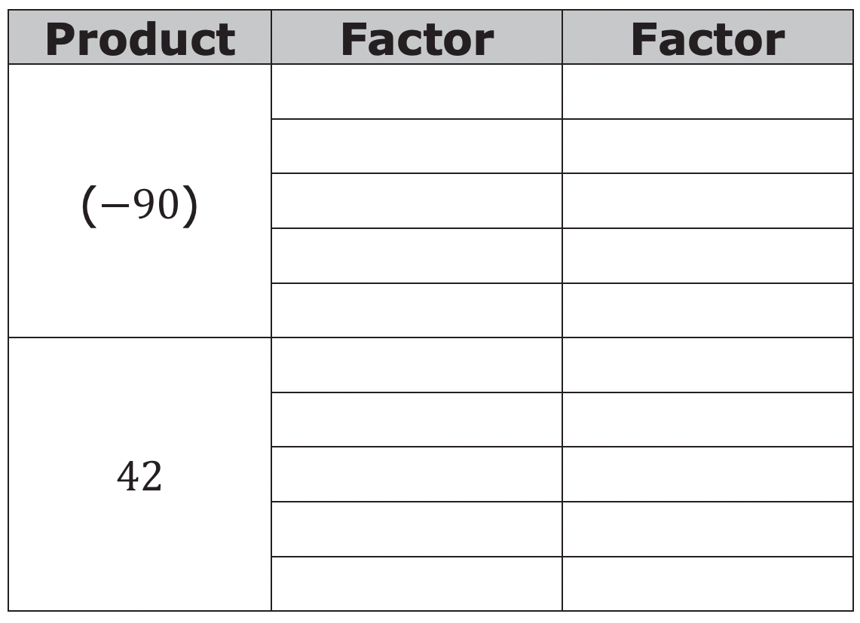
6.11.3 Collaboration: Multiplying and Dividing Integers
1. The table shows two different products. Work with your partner to find five different factor pairs that, when multiplied, will result in the product. The factors cannot include 1 or −1.
2. Explain a strategy or an approach that each partner suggested.
3. Explain which of the products, (−90) or 42, was the easiest to find factor pairs for and why.
volume 1, pg. 285

Slide 11
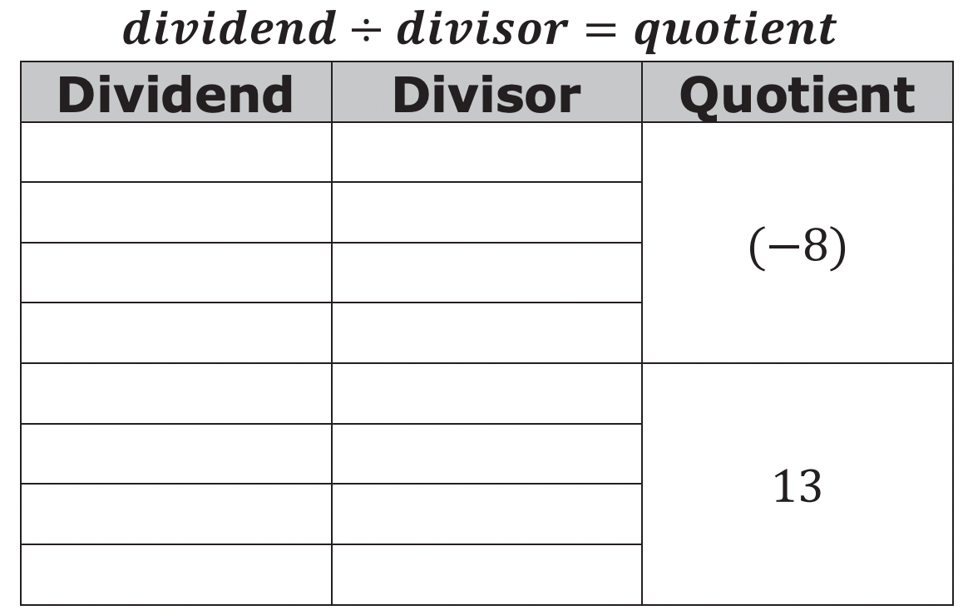
4. The table shows two different quotients. Work with your partner to
find four different pairs of dividends and divisors that result in the given quotient when they are divided. The numbers 1 or −1 cannot be used.
5. Explain a strategy or an approach that each partner suggested.
6. Explain which of the quotients, (−8) or 13, was the easiest to find dividends and divisors for and why.
volume 1, pg. 285

Slide 12

Guided Practice
volume 1, pg. 286

Slide 13


6.11.4 Guided Practice: Finding Missing Factors, Products, or Quotients
1. Fill in the missing values to make each equation true.
(−7) ∙ ____ = −14
____ ÷ (−5) = 7
$\frac{−40}{8}$ = ____
____ × (−9) = 63
volume 1, pg. 286

Slide 14
Consider the equation shown. Phillip said −12 is the missing factor while Alicia claimed it is 12.
(−1) ∙ (−2) ∙ _?_ = 24
Explain which student is correct using, rules for multiplying integers.
volume 1, pg. 286

Slide 15

Your Turn
volume 1, pg. 286

Slide 16
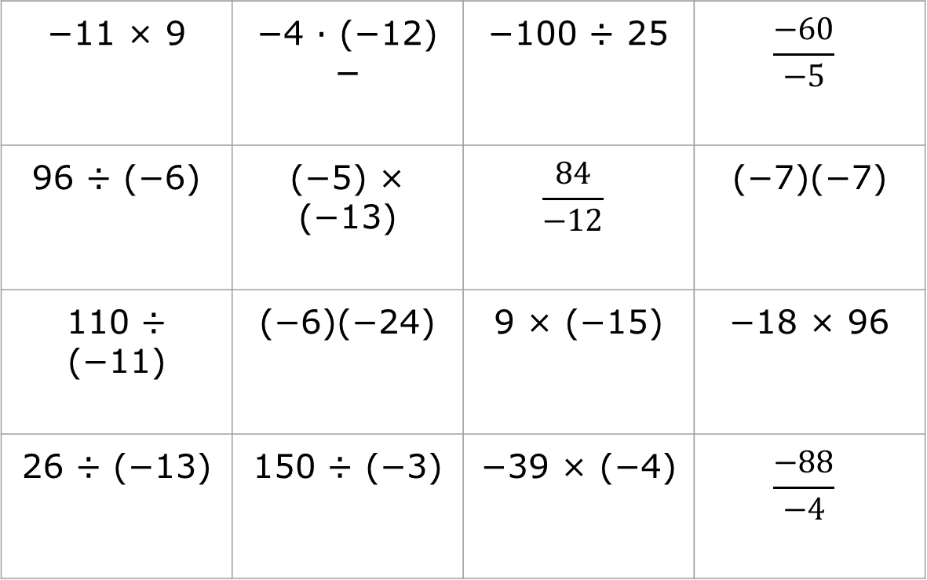
6.11.5 Your Turn!
1. Find each product or quotient.
−11 × 9 | −4 ∙ (−12) − | −100 ÷ 25 | $$\frac{−60}{−5}$$
96 ÷ (−6) | (−5) × (−13) | $$\frac{84}{−12}$$ | (−7)(−7)
110 ÷ (−11) | (−6)(−24) | 9 × (−15) | −18 × 96
26 ÷ (−13) | 150 ÷ (−3) | −39 × (−4) | $$\frac{−88}{−4}$$
volume 1, pg. 286

Slide 17

Wrap-Up
volume 1, pg. 287

Slide 18
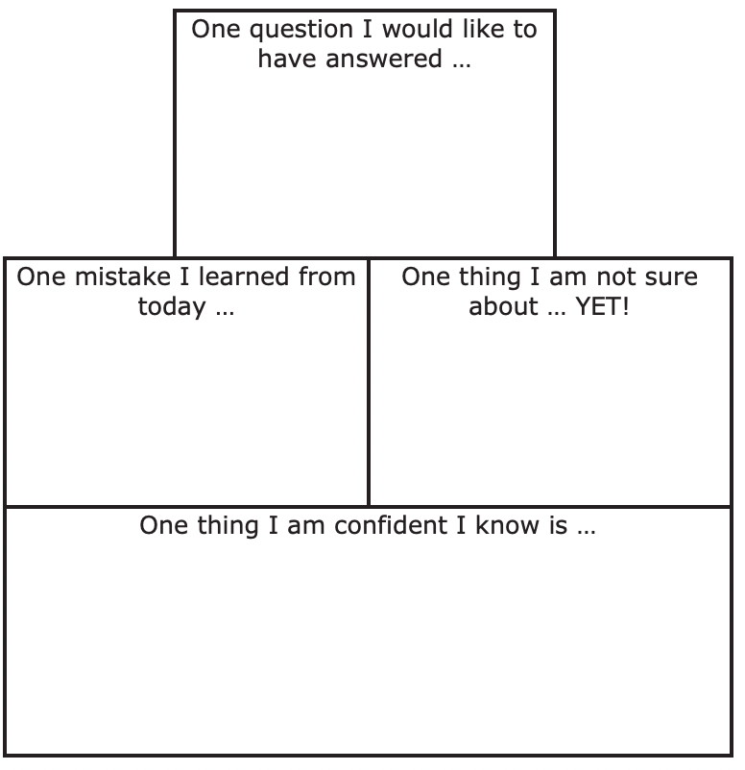
6.11.6 Wrap-Up: Reflection
1. Complete the learning period based on today’s lesson.
volume 1, pg. 287

